Slide 1

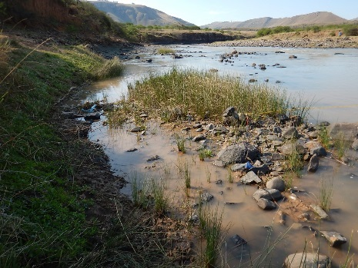

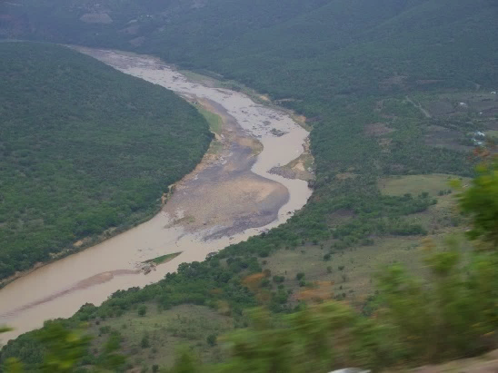
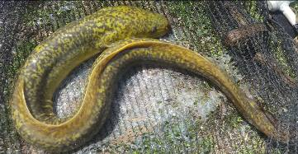
WP 11004: PSC MEETING 3,
13 February 2018
PRESENTATION TITLE
Presented by:
Name Surname
Directorate
Date
DETERMINATION OF WATER RESOURCE CLASSES AND RESOURCE QUALITY OBJECTIVES FOR THE WATER RESOURCES IN THE MZIMVUBU CATCHMENT:
WATER RESOURCE CLASS DETERMINATION TOOL
Colin Talanda

Slide 2
PROJECT PLAN

Slide 3
AIMS
What is the Water Resource Class Determination Tool (previously referred to as the MCDA)
How does this tool work
The purpose of this tool

Slide 4
WHAT NEEDS TO BE BALANCED?
Degree of the ecological health defined by Ecological Categories of biophysical nodes (non-monetary)
Ecological Goods and Services Attributes (non-monetary)
Socio-Economic implications (quantitative: monetary and job count)
Notes:
Bigger picture of why/what needs to be balances

Slide 5
INTEGRATED RANKING OF SCENARIOS
(WHY MULTI-CRITERIA ANALYSIS?)
Method to compare alternatives where the outcomes (consequences) are in different numerical terms.
Ecological consequences is a relative rating while economy is in monetary terms and employment in numbers.
Multi-Criteria Analysis is appropriate in these circumstances.

Slide 6
HOW IS IT RATED?
Ecological consequences are rated according to the degree that the Recommended Ecological Category is met (so the REC is the top of the scale).
Ecosystem Services: Present state is “1.0” with relative rating for scenarios.
Economic Indicator generally uses GDP or other relevant comparative monetary indicator.
Employment / number of jobs as affected by scenario, also used.
Integrated rank: weighted scores of above 4 variables – two methods of ranking.

Slide 7
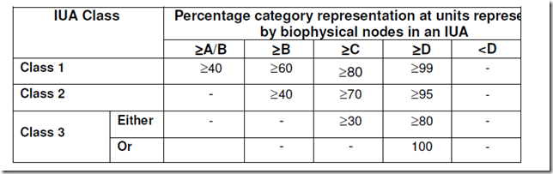
B
Scenario D
Deriving the Management Class
Stream Flow Reduction Activity
Small Dams
B
 | Node grouping in Ecological Categories (EC) (outcome from Scenario D)
EC | A | B | C | D | E
Number | 0 | 2 | 4 | 2 | 1
% |  | 22.2 | 44.4 | 22.2 | 11.1
Weighted % |  | 20.8 | 50.9 | 24.5 | 3.8
Scenario D
Results
D
D
Rural
Irrigation
Rating Rules
Rural
C
Nature Reserve
E
C
Irrigation
C
Industrial
Urban
Water Resource III
C
Biophysical Node
EWR Site
Estuary
Notes:
Is this an IUAUnit Percentages:
Length of river in a given Ecological Category divided by the total river length in an IUA .

Slide 8
VARIABLE SCORES AND WEIGHTS
Variables | Scenarios
 | 3 | 41 | 42 | 43
Ecological Status | 0.77 | 0.94 | 0.92 | 0.91
Ecosystem Services | 1.01 | 1.00 | 1.06 | 1.06
Economic Indicator (GDP) (R Millions) | 39 637.7 | 15 808.4 | 25 713.5 | 23 996.7
Employment | 2 1661 | 6 427 | 11 360 | 10 412
Variables | Weights
Ecological Status | 0.5
Ecosystem Services | 0.05
Economic Indicator | 0.2
Employment | 0.25
50% Ecology
50% Socio-Economic

Slide 9
QUESTIONS FOR CLARIFICATION

